Slide 1
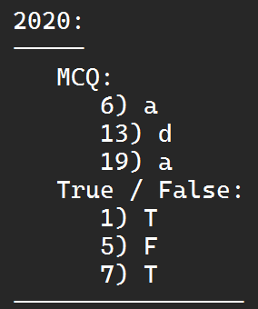
Emulation {Final 2017}
A technology that enables one device (Host) to function like other systems (Guest).
Virtualization {Final 2017}
A technology to run multiple same or different isolated OSs on a single physical system by abstracting and partitioning it’s physical resources into multiple VMs with different workloads to improve IT throughput and cost.
{OSs can run concurrently, each in it’s own virtual machine.}
MCQ – T F

Slide 2
{Final 2015 - 2017} |  | Full Virtualization | Para Virtualization | OS-Level Virtualization
Similarity |  | They are all methods that allow virtualization to occur on a single physical machine
Differences | Host OS | Not Exists | Exists | Exists
Differences | Functionality | Run multi-unmodified guest Oss by sharing the resources of a single hardware across them. (by using hypervisor) | Run Modified guest Oss by communicating directly to the virtualization layer. (hypervisor) | Creates isolated containers from a single physical server and OS instance. (all have the same OS functionality)
 | Example | VMware | Xen | FVM

Slide 3
{CE 2022} | Dual Boot System | Emulation System |  |  | Virtualization System
Similarity | All are methods to enable running a different OS than the host OS.
Difference | 2 OSs are installed on the same hard drive allowing either of them to be loaded and given control. | A system pretends to be another system. | A system pretends to be another system. | A system pretends to be two or more another systems by partitioning physical resources into multiple VMs with different workloads. | A system pretends to be two or more another systems by partitioning physical resources into multiple VMs with different workloads.

Slide 4
{CE 2022} |  | Virtual Machine | Container
Similarity |  | Both are technologies that allow for the creation of isolated environments that can run software and applications independently of the underlying physical hardware or host OS.
Differences | Virtualization Technology | Hardware Virtualization | OS Virtualization
 | OS | Each VM has it’s own OS | All Containers share host OS
 | Startup | Slow (because of isolated OS) | Fast (because of kernel)
 | Portability | Less Portable | More Portable
 | Security | Better Security (because of isolated OS) | Worse Security (because of shared OS)

Slide 5
Virtualization in ISA Level {Final 2015}
It’s emulating a given ISA by the ISA of the host machine.
This allows an operating system written for the emulated ISA to run on the host machine, even if it’s not compatible with the host machine's hardware.
Advantage => Best Application Flexibility.
Disadvantage => May be slow.

